Slide 1

Salary Prediction with Linear Regression
This presentation explores the development and deployment of a machine learning model for salary prediction using linear regression. The model is built using Python and deployed with Streamlit for user interaction.

Slide 2
Project Overview
Objective
Methodology
Deployment
Develop a predictive model to estimate salaries based on education, experience, and job title.
Utilize linear regression to create a machine learning model for salary prediction.
Deploy the model using Streamlit to provide an interactive user interface for salary predictions.

Slide 3
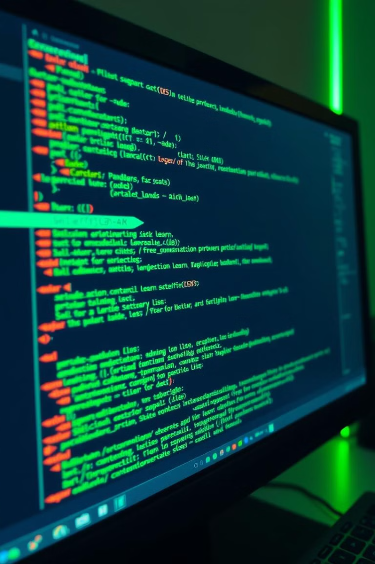
Technical Stack
Python
The primary programming language for data analysis and model building.
Pandas
A powerful library for data manipulation and analysis.
Scikit-learn
A comprehensive machine learning library for model training and evaluation.
Streamlit
A framework for building interactive web applications.

Slide 4
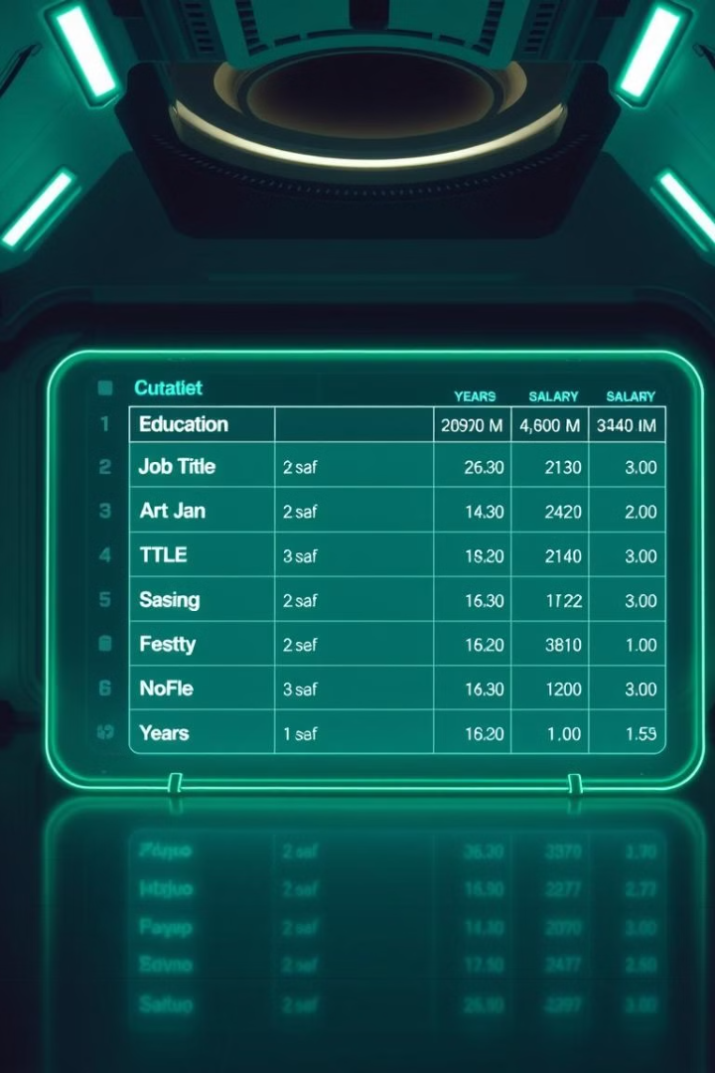
Dataset Overview
Feature
Description
education_level_encoder
Encoded education level (e.g., Bachelor's, Master's)
job_title_encoder
Encoded job title (e.g., Software Engineer, Data Scientist)
Years of Experience
Total years of professional experience
Salary
Predicted salary based on the input features

Slide 5
Model Training and Evaluation
Data Preprocessing
Model Training
Model Evaluation
Train a linear regression model on the preprocessed data to learn relationships between features and salary.
Evaluate the model's performance using metrics like mean squared error and R-squared.
Prepare the data for training by handling missing values and encoding categorical features.

Slide 6
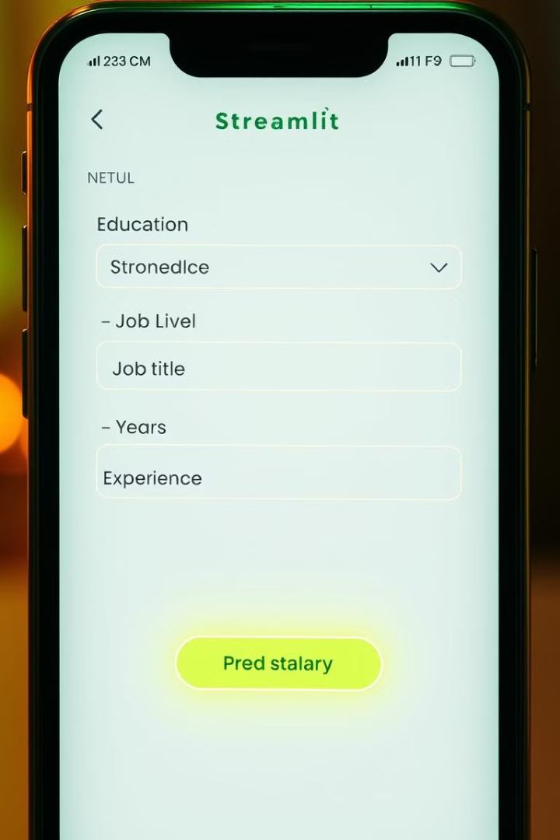
Streamlit Deployment
User Interface
Create an interactive web interface using Streamlit to allow users to input their information.
Prediction Logic
Implement the prediction logic within the Streamlit app to process user inputs and generate salary estimates.
Result Display
Display the predicted salary to the user in a clear and concise manner.

Slide 7

Installation and Usage
git clone https://github.com/yourusername/salary-prediction.git cd salary-prediction
Follow these instructions to set up and run the salary prediction application. The repository contains code for the model training, evaluation, and deployment, enabling you to explore the project and experiment with the model.

Slide 8

Conclusion and Next Steps
1
Model Performance
The linear regression model achieved satisfactory performance on the salary prediction task.
2
Future Enhancements
Consider exploring more advanced regression techniques or incorporating additional features for improved accuracy.

